Slide 1


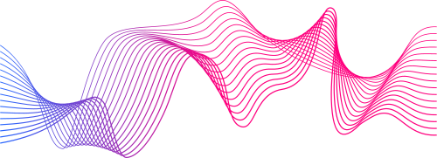
5/19/2025
EKGenie
PRESENTED BY:
A Smart Diagnostic Tool for Heartbeat Irregularities
Paige Lui
Evan Ingalls Hawraa Al Hasnawi

Slide 2
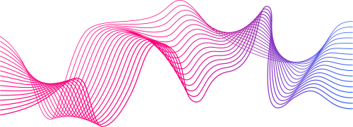
Meet the Team
Evan
Circuit design/ User interface
RNN model development
Hawraa
Data visualization/ Preprocessing
Naive Bayes model development
Paige
Documentation
Feature selection
CNN model development

Slide 3
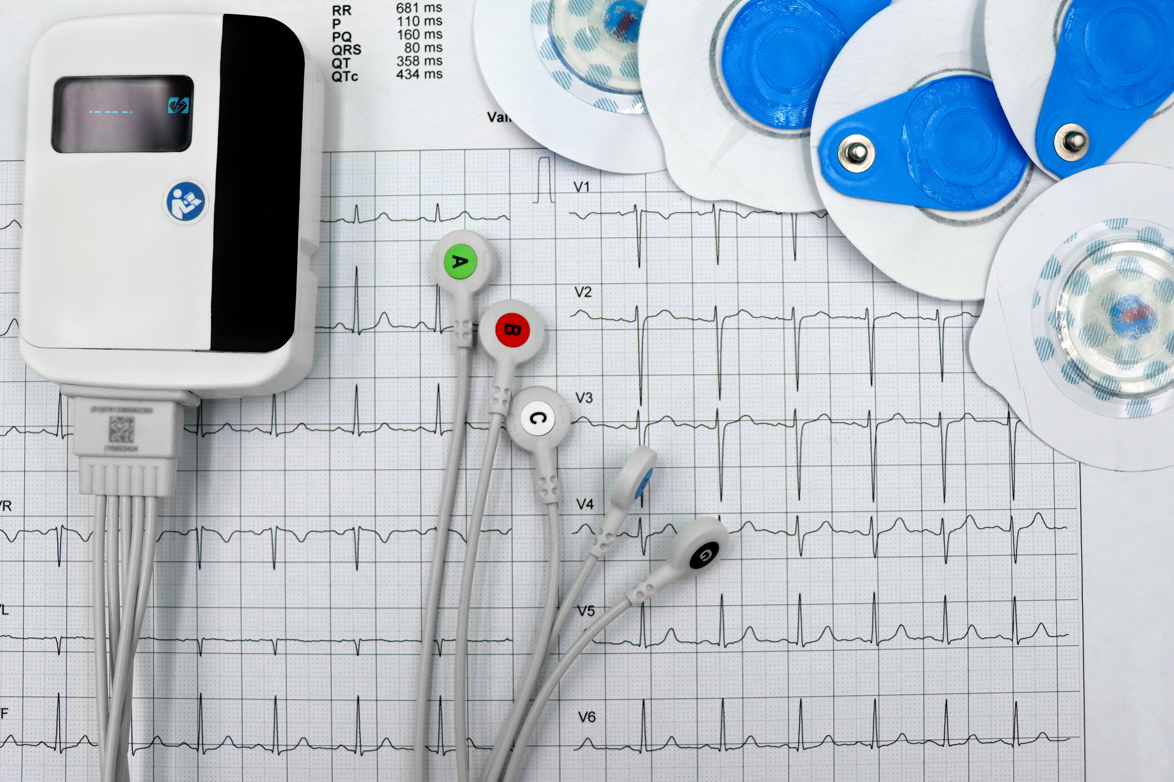
The Problem
Undiagnosed cardiovascular abnormalities can range from minor to life-threatening and may
manifest with varying symptoms or no symptoms at all.
Early detection and treatment are crucial
for managing these conditions and preventing complications like heart attack or stroke.

Slide 4
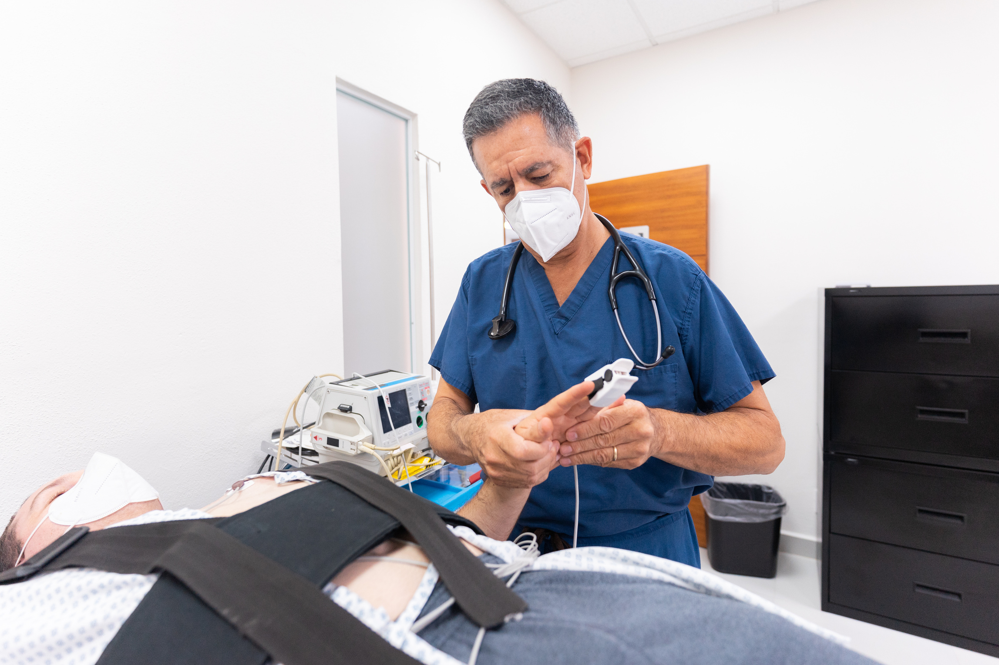
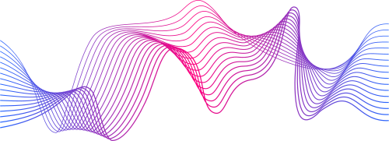
Our Solution
Machine Learning
Using open source data we will train a model that can recognize the patters present in irregular cardiovascular behavior. It will pass recorded data to our model to classify most probable causes of the signal.
Hardware Integration
An Arduino module will measure the patient’s electrical pulses controlling their heart and transmit data back to the user interface..

Slide 5
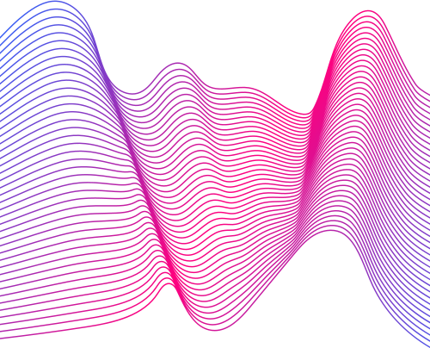
80%
OBJECTIVE # 1
Achieve recall and accuracy rates be 80% or greater.
Objectives
Device
OBJECTIVE # 2
Construct a fully functioning biomedical device to test our model.

Slide 6

Our Methodology
Model Development
EKG System
Naive Bayes
True baseline model - helpful for checking data cleaning and as comparison for more complex models
CNN
A deep learning technique that is very well suited for time series data, like ECGs.
RNN
Neural network that has working memory and can process sequential data.
Arduino
AD8232 module (3-lead EKG)
Arduino script (C++)
Connect to computer
Python Script (TKinter)
controls hardware
shows signal output
displays prediction

Slide 7
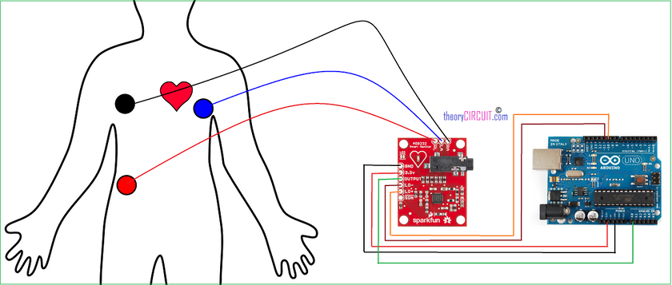
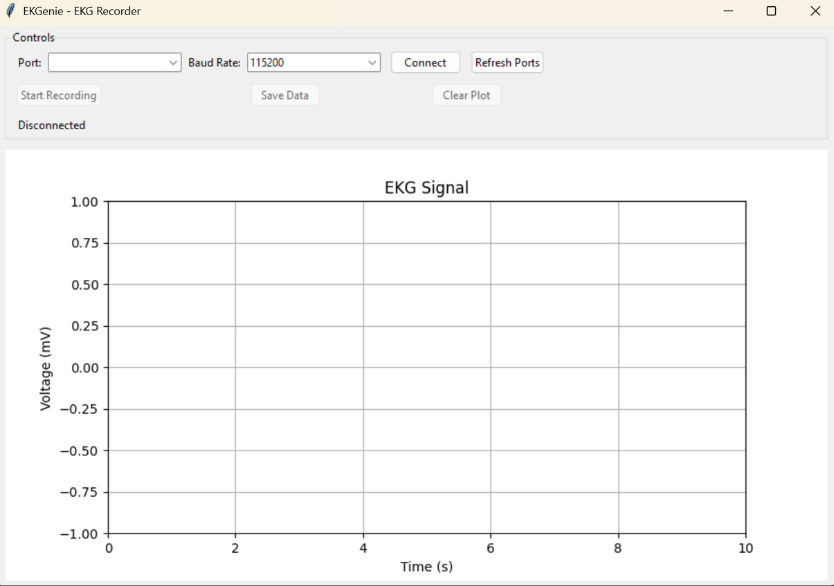
How does it work?
The interface will allow users to connect to their machine to the device and record their heart’s behavior.
Arduino module records electrical activity in the body and sends serial data to port.
On completion it will predict the most likely case and output the results to the monitor.

Slide 8
Our Data
Goldberger, A., Amaral, L., Glass, L., Hausdorff, J., Ivanov, P. C., Mark, R., ... & Stanley, H. E. (2000). PhysioBank, PhysioToolkit, and PhysioNet: Components of a new research resource for complex physiologic signals. Circulation [Online]. 101 (23), pp. e215–e220.
THE MIT-BIH ARRHYTHMIA DATABASE CONTAINS 48 HALF-HOUR EXCERPTS OF TWO-CHANNEL AMBULATORY ECG RECORDINGS, OBTAINED FROM 47 SUBJECTS STUDIED BY THE BIH ARRHYTHMIA LABORATORY
MIT-BIH Arrhythmia
48 half-hour excerpts of two-channel ambulatory ECGs
Digitized at 360 samples per second per channel
47 subjects
23 chosen at random from 4000 ECGs over a 24 hour period
25 selected from that set for rarer arrythmias
PTB Diagnostic ECG
549 high-resolution 15-lead ECGs
From one to five ECG records are available for each of the 294 subjects, who include healthy subjects as well as patients with a variety of heart diseases.

Slide 9
Data
Preprocessing
Model
Python GUI
EKG
Human
Resampling
Classification
Denoising
Smoothing
Label Balancing
System Architecture
Training

Slide 10
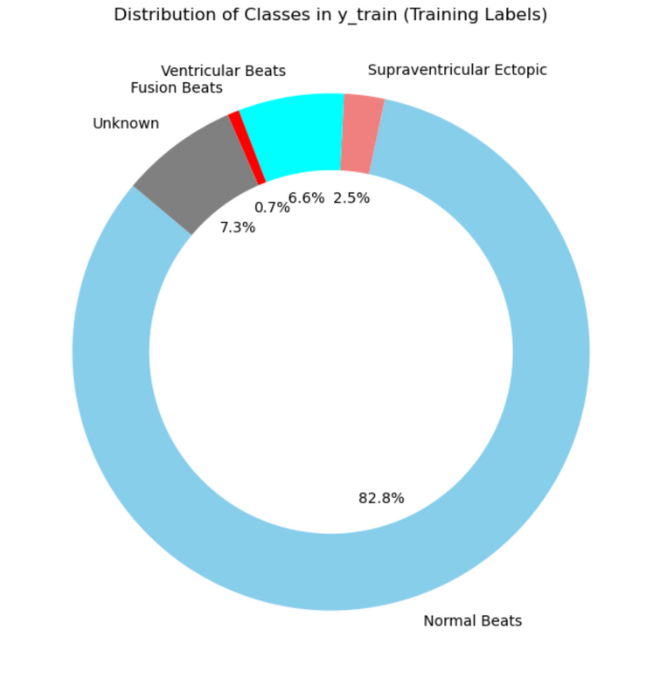
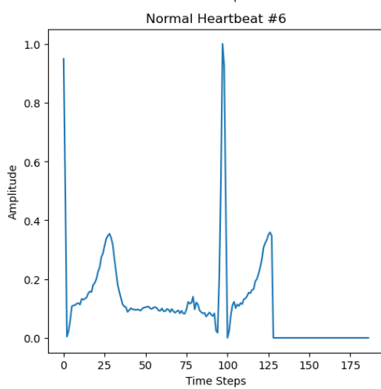
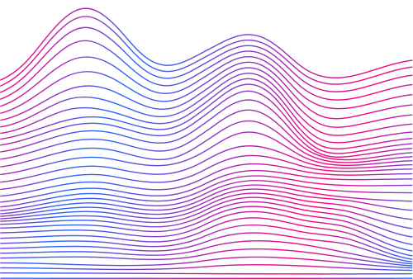
Data Visualization
IMAGE 1
IMAGE 2
A Pie Chart for the MIT-BIH database
A line chart showing amplitude averages for the PTB database normal heartbeats

Slide 11

Feature Engineering
Our feature engineering choices:
Remapped label 6 into label 0
Label 6 and label 0 are both normal heartbeats from the two different datasets which had to be integrated
Normalization
Assists with model stability
We chose not to create new labels beyond what was necessary to combine the two datasets, since the accuracy of medical data is so important

Slide 12
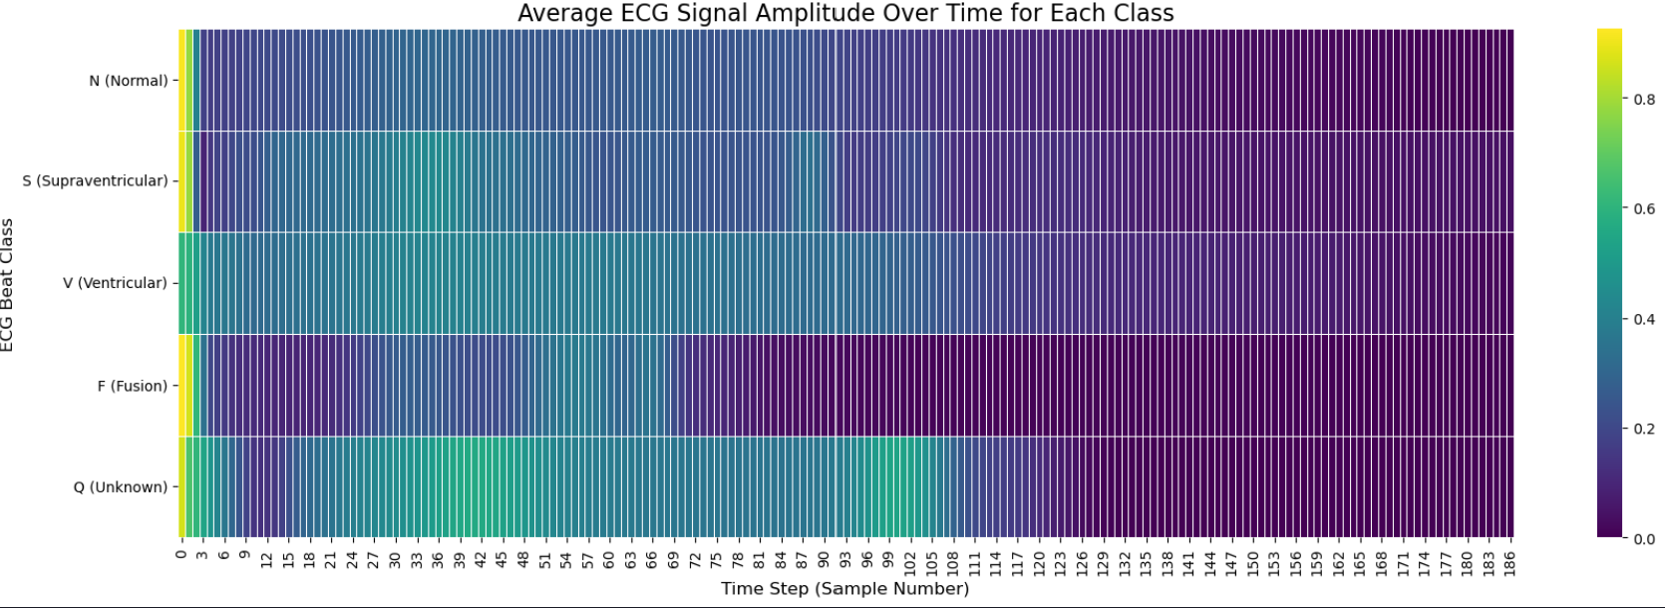
Feature Selection
Limited feature selection:
Similarly to feature engineering, we chose to not remove any rows as we felt that it was better to use more data to get better and more accurate models
We chose to remove columns where greater than 80% of the values were zero
IMAGE 3
A heat map showing relative importance at different time steps

Slide 13
ML Models
Trained to learn spatial patterns in the ECG signals, serving as a strong baseline model
CNN
Captures sequential dependencies in ECG signals
RNN
Evaluates how well simple statistical assumptions perform on the cleaned ECG features
Naive Bayes

Slide 14
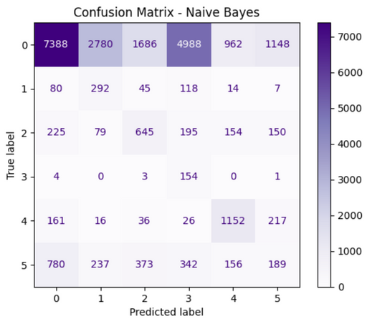
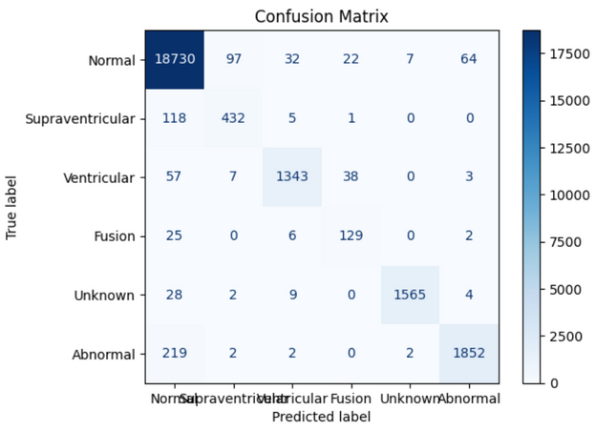
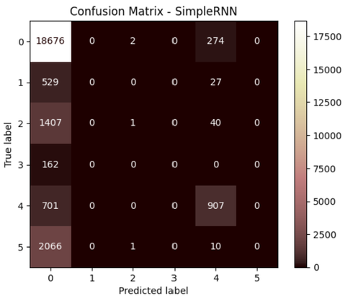
Experiments
IMAGE 4
Confusion matrix for Naive Bayes model
Experiments focused on comparison between baseline (Naive Bayes) and deep learning models
CNN managed to improve upon both accuracy and recall
RNN improved upon accuracy, but struggled with recall
Key findings:
CNN outperformed both the Naive Bayes model and the RNN
Both the RNN and Naive Bayes model performed well with the majority class, but struggled when it came to minority classes
IMAGE 5
Confusion matrix for CNN
IMAGE 6
Confusion matrix RNN

Slide 15
Evaluation Metrics
Our main criteria for success were to have an accuracy and recall greater than 80 percent. Additionally, we sought to have AUC scores above 0.8, with an ideal being above 0.9. In practice our results were:
CNN (macro) - Test Accuracy: 91%; Recall: 89%; AUC (average): 0.99
RNN (macro) - Test Accuracy: 79%; Recall: 28%
Naive Bayes (macro) - Test Accuracy: 24%; Recall: 51%
Based on the results from our current models, we have successfully hit our success criteria with our CNN model, but our RNN model could use further refinement in upcoming weeks

Slide 16
What’s Next?
5/26
6/2
6/9
6/16
Here’s a t timeline moving forward
Hardware Construction and Integration
Device Testing and Optimization
Final Adjustments and Deployment Prep
Final Deployment

